Slide 1
Automatic greenhouse roof
Bădău Elena Nicoleta
Zah Elena

Slide 2
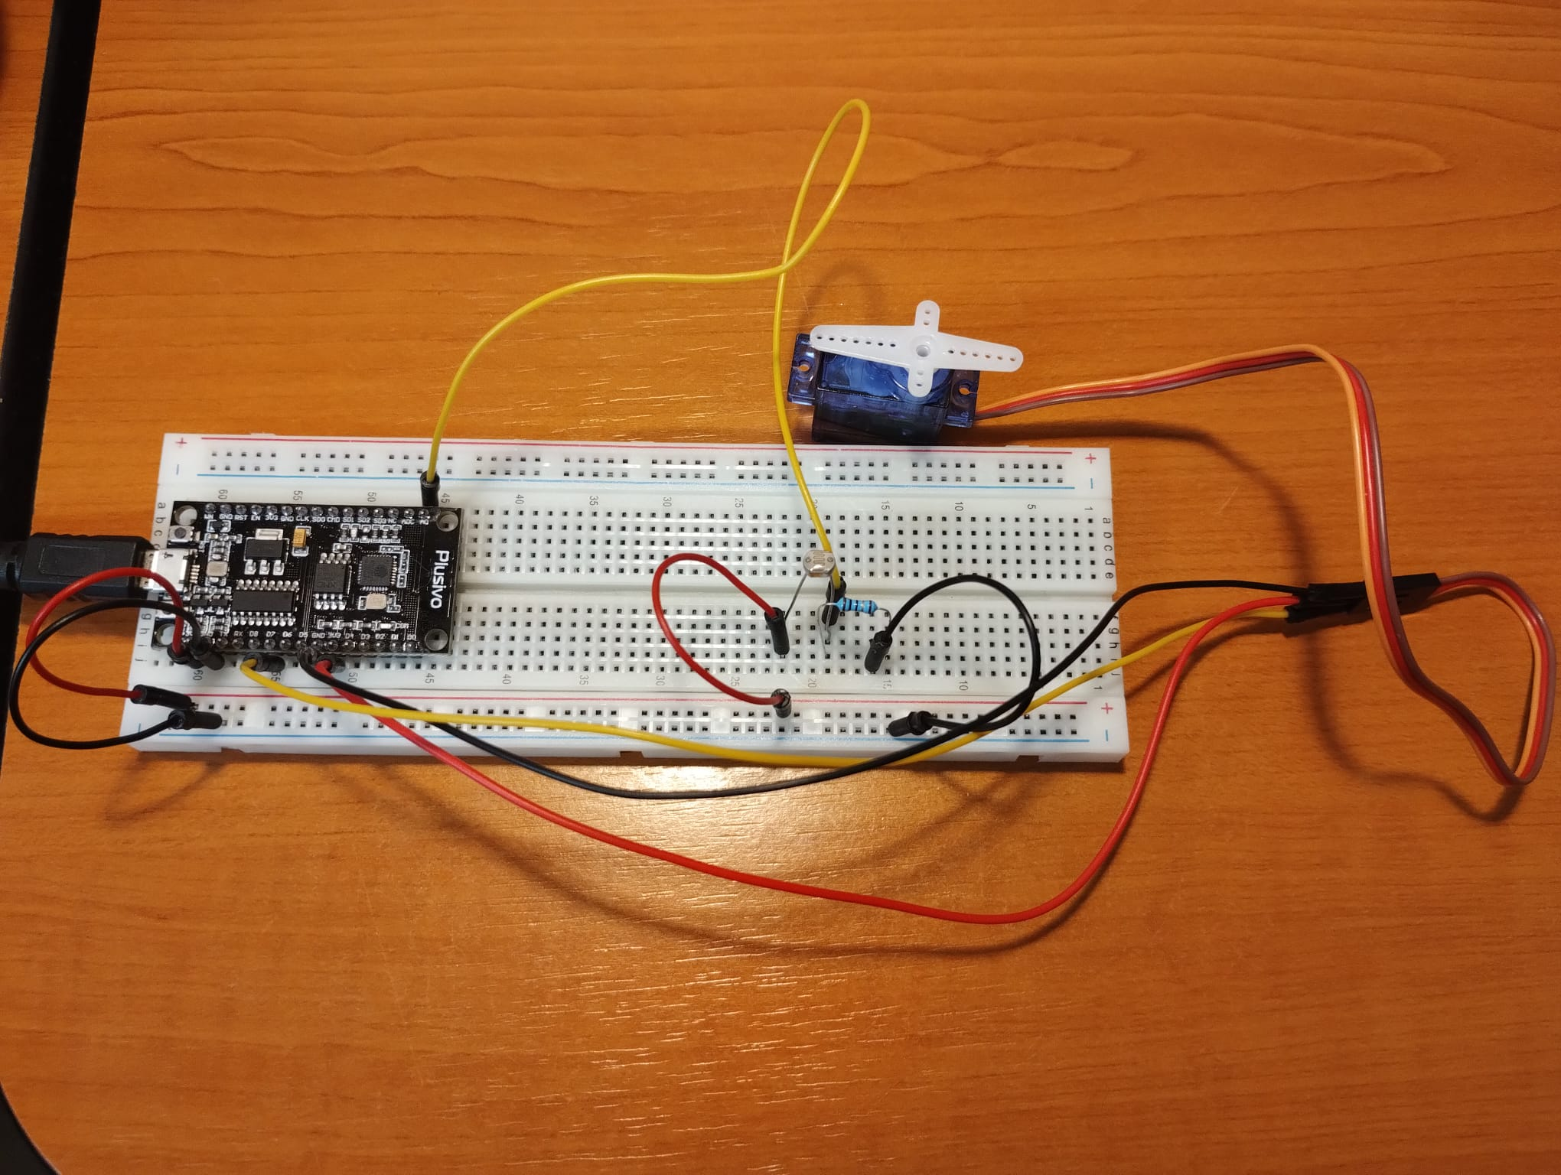
Components

Slide 3
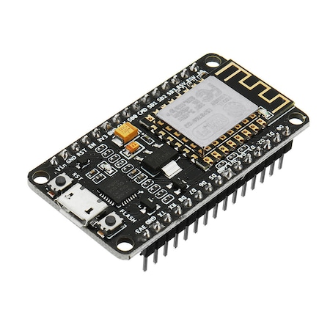
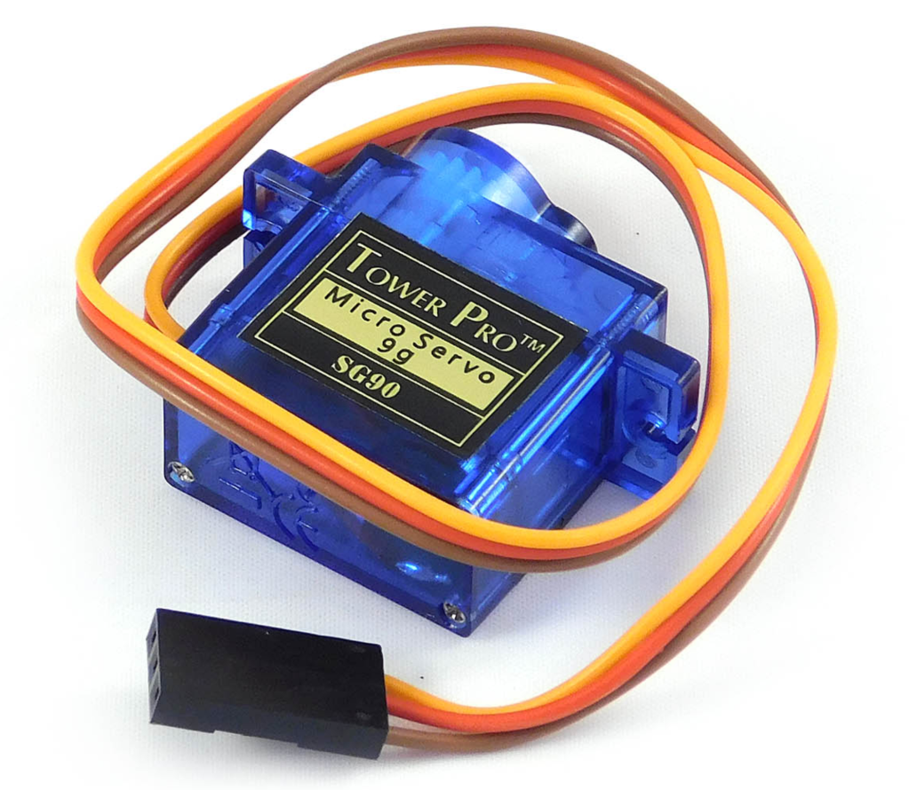
ESP8266
Servo Motor
32-bit microcontroller capability : GPIO pins allow Analog and Digital IO, plus PWM, I2C, etc.
integrated TCP/IP protocol stack, can be used as a Wi-Fi module for IoT projects
Can rotate about 180 degrees (90 degrees in both directions)
Power supply voltage: 4.8V
Specially designed for low power applications

Slide 4
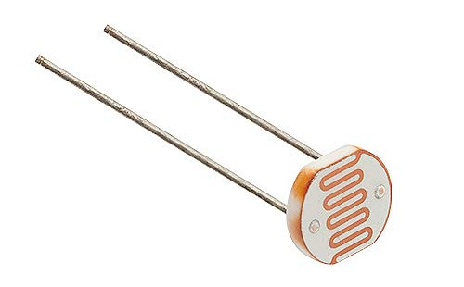
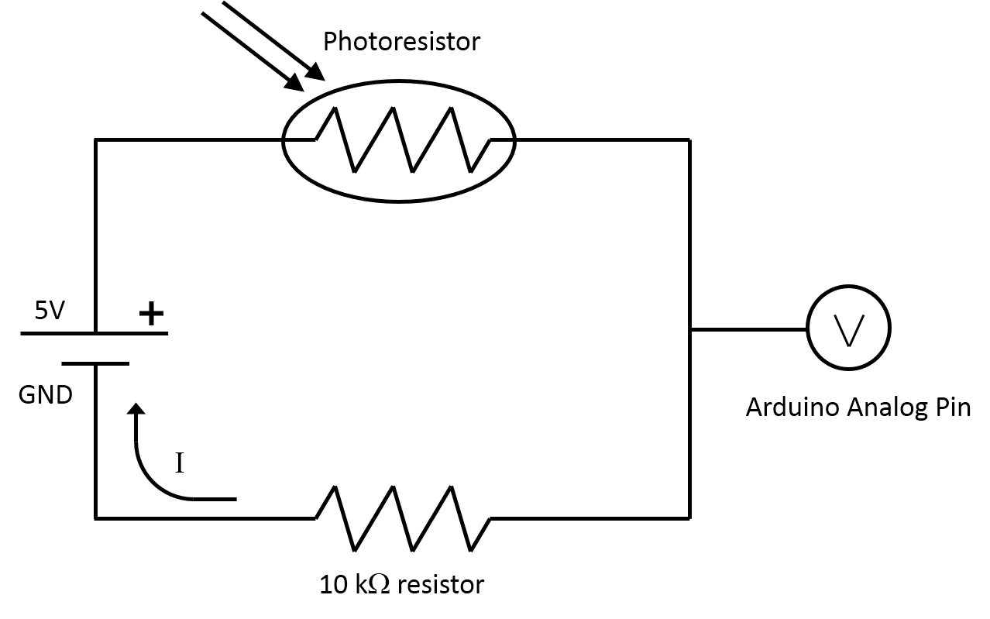
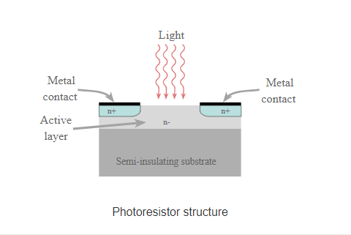
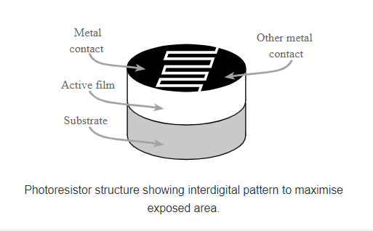
Photoresistor Sensor
circuit layout
Working principle :
the resistance of a photoresistor decreases with increase in incident light intensity

Slide 5

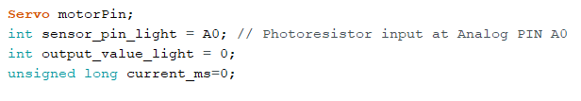
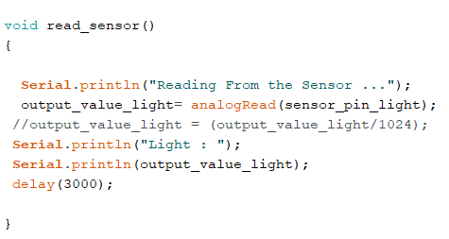
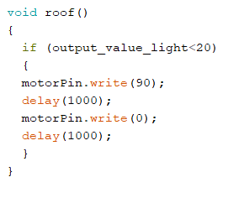
Overview of the code for the hardware part

Slide 6
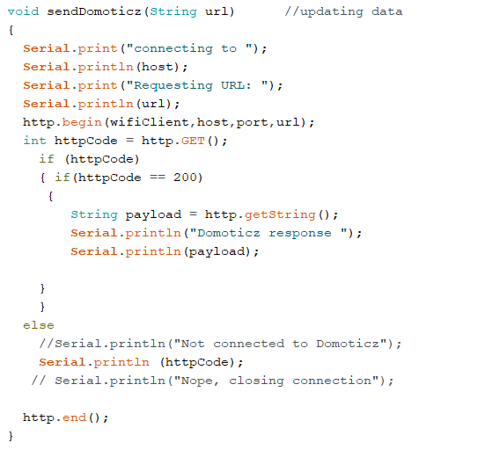
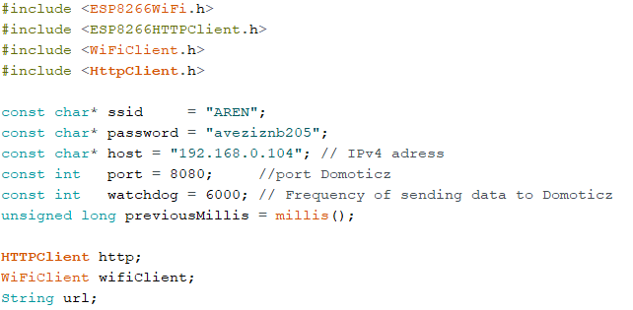
Overview of the code for the connection with Domoticz (1)

Slide 7
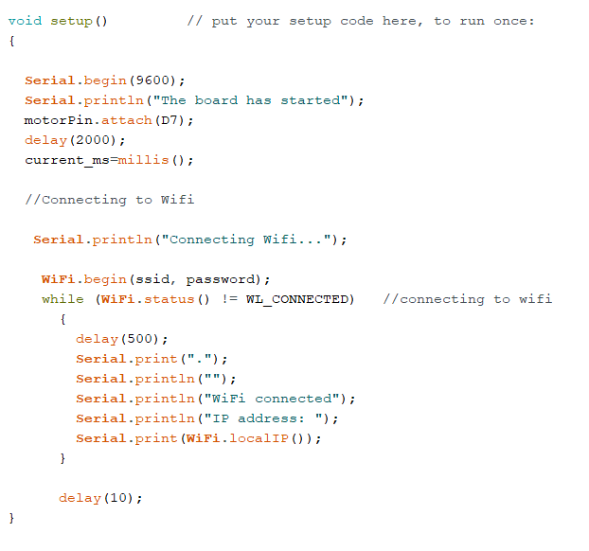
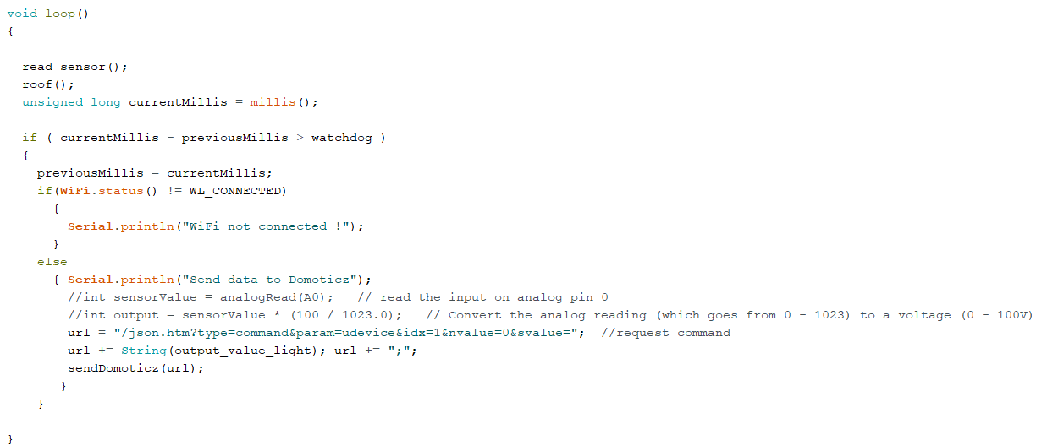
Overview of the code for the connection with Domoticz (2)

Slide 8
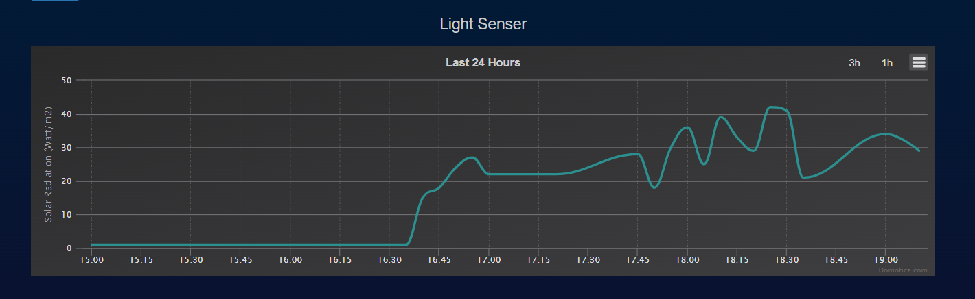
Domoticz platform (1)

Slide 9

Domoticz platform (2)
an accessible Home Automation System who enables monitoring and control over devices such as switches and sensors for temperature, gas, pressure, etc.
easy-to-use interface and database
notifications and alerts sent in real time to any device connected to the server
adapted for desktop and mobile devices
compatible with all recent browsers
more information on the website: http://www.domoticz.com

Slide 10

Thank you !

